Slide 1

City of Columbus Tracking System Monitoring Tools for an Enterprise GIS Jaclyn Meade – Software Engineer Department of Technology, GIS Division
Notes:
This presentation is focused on a project we did this year to deploy freely available monitoring tools to track our enterprise system. If you are a system administrator or manage any part of your GIS, there will definitely be something here that you can easily deploy to track a part of your enterprise system and gain valuable insight into your organization.

Slide 2
Outline
Background / Why Tracking
Research
Tracking the Following
Desktop License Manager
Web Applications
ArcGIS Server
SDE Databases
Resources
Notes:
Feel free to ask questions

Slide 3

Project Background
Organization Stats
City of Columbus
15th Largest City in the US
Departments Include: Police and Fire, Utilities, Zoning, Public Service, Development, Parks and Recreation
Infrastructure Stats
7 SDE Databases / 400+ Feature Classes
Hundreds Desktop Users and Editors
29 Servers / 38 Supported Applications
Notes:
- All of this with 2 engineers and a GIS manager

Slide 4
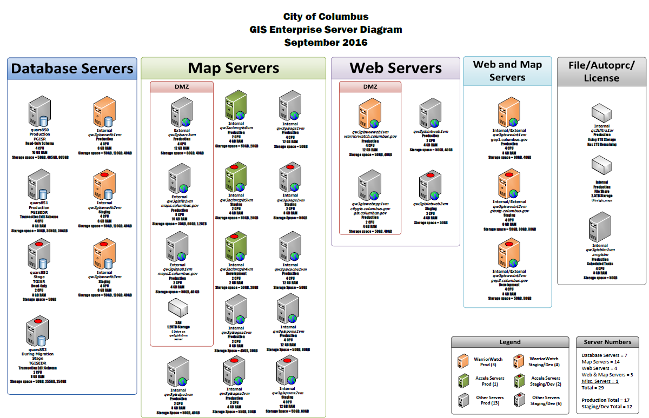
System Administration Need
Who is in my system?
What are they doing?
When are they here?
Where are they going?
How Much are they doing?
Notes:
Need
Important thing here is that we don’t have the ability to talk to all of our end users to find out what are using, we needed a way to cast a net over our system and collect that data information in an automated way
Understanding leads to optimizations
Drive GIS Strategic Plan – understand what are users consuming and give them more of that

Slide 5
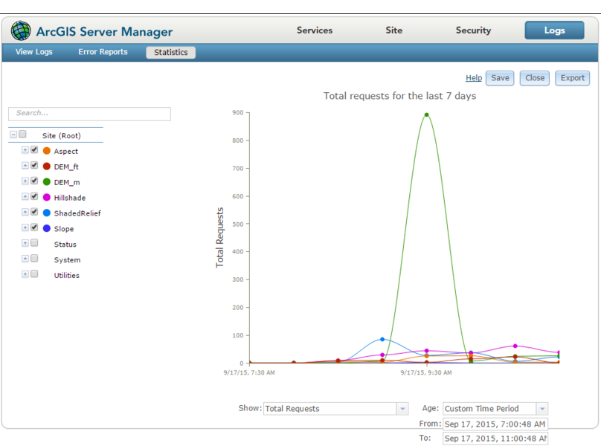
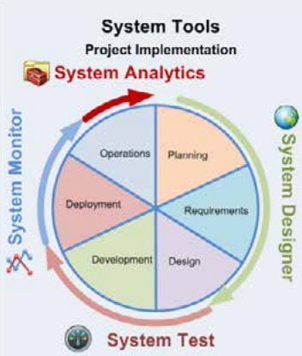
Tracking Research - Esri Software
ArcGIS Server 10.3.1
Built in short term monitoring
Esri Professional Services
Developed custom applications
and tools for managing all stages
of a GIS
Presentation System Best Practices
http://proceedings.esri.com/library/userconf/devsummit13/papers/devsummit-021.pdf
Professional Services Resources
http://www.arcgis.com/home/search.html?q=owner%3AEnterpriseImp&restrict=true
System Monitor
http://www.arcgis.com/home/item.html?id=848f48b0f88e4de7a036377197453efe
Notes:
- First step to our project

Slide 6
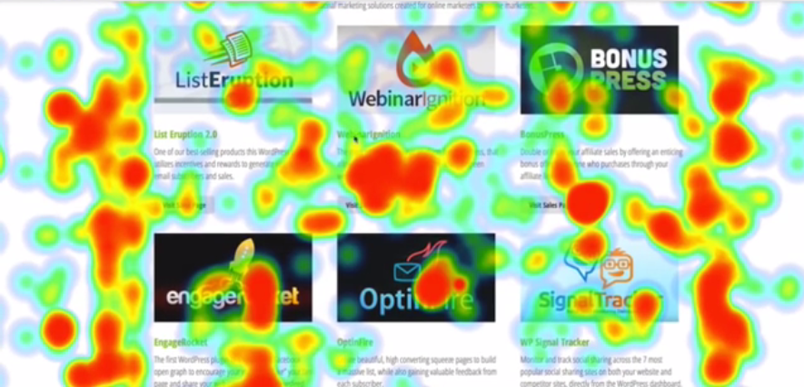
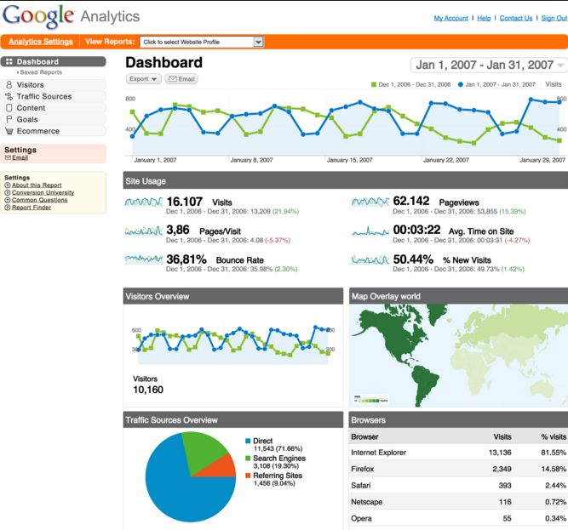




Tracking Research – Web Applications
Google Analytics
Page Hits
Operating System Details
Location of User Community
Network
Time of day Charts
Live Activity
Hosted Solution
Heatmap Tracking
Click heatmaps
Mouse hover heatmaps
Session Replay
Same statistics as Google Analytics
Hosted and Self-Hosted Solutions
NetInsight
Self Hosted Version
www.google.com/analytics/standard
www.ndm.net/ecm/IBM/unica-netinsight
doc.unica.com/products/netinsight/8_6_0/en_us/IBMUnicaNetInsight860ReportsUsersGuide_en_us.pdf

Slide 7
Tracking Research – 3rd Party Software
Latitude Geographics - Geocortex Analytics
Formerly Geocortex Insight
System Status
Service Status
Trends
Dashboard
Reporting
Alarms
Vestra – Geosystem Monitor Enterprise
Individual Rest Services
ArcGIS Online services/ Web Maps
Database/SDE Layers/Usage
Web Applications
Alerts and Reporting
Maptiks – Web Map Analytics
User pans, zooms, clicks, loads
Map Bounce Rate
Visitor Duration
Activities/Sessions
Vestra – Geosystem Monitor ArcGIS Online
Web Maps and Applications
Alerting
Performance monitoring
http://www.geocortex.com/products/geocortex-analytics/
www.vestra.com/geosystems-monitor-arcgis-online
https://marketplace.arcgis.com/listing.html?id=a5e4a3e9746049dab0cbaf136b61666e
www.vestra.com/gis/products/geosystems-monitor
Notes:
Latitude Geographic – Cost of at least $8500 to start then $3000 for annual maintenance. Not sure cost of vestra

Slide 8
Four Tracking Elements
Desktop
(License Manager)
Web
Applications
ArcGIS
Server
Databases
Three Phases to Tracking
Track
Analyze
Action
Notes:
These were the main elements to our system that we wanted to collect information on. For each of these four elements we worked on deploying tracking, creating templates to analyze the data generated, then the decisions and actions that can be taken from there. All of the details from deployment to template examples are available on the GIS Wiki, at the end I will give you that link.

Slide 9
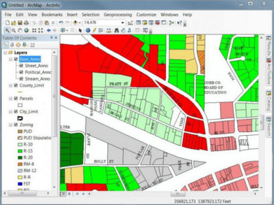
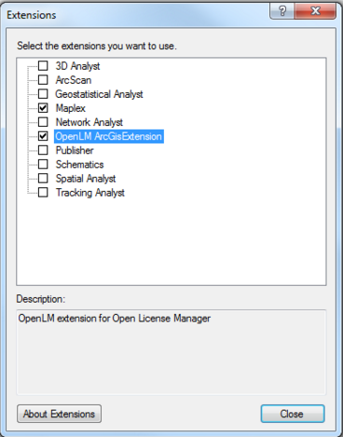
Desktop
1
License Manager Batch
Notes:
Main things I am interested in from a desktop perspective
What programs are my users using (discuss recent migration from 10.0 – 10.3.1, included over 2,000 installations of ArcReader and ArcGIS Desktop)
What is the daily license consumption/what is my to date maximum license usage? We have an ELA, but imagine how beneficial that would be to see you only ever consume 6 concurrent licenses, but you are paying ESRI for 10.
Also track extensions users use, indicate what tools your users use and guide training towards those tools

Slide 10
Desktop – Tracking Tool
What is it?
License Manager Batch File
How do you set it up?
Task Scheduler to run batch
Executes lmutil.exe lmstat parameter
Write to txt file
What does it do?
Report time
Product (Extensions)
User
PC Name
Session Start
Tip: If you run the batch as you, remember to update the password when you change it
Also – Single Use Licenses will not be captured
1
Notes:
What is it
How do you set it up
What does it do

Slide 11
Desktop – Analysis
How to Analyze – Excel Template with Pivot Tables
Max Concurrent = 184
Average = 66.5
Total Hours = 211,419
Active ArcGIS Desktop Users = 305
1
Notes:
How did we Analyze?
- Simple template that processes that txt file into a spreadsheet that we then configured pivot tables to answer these questions

Slide 12
1

Slide 13
Desktop – Action
Better Understand of User Community
Effective Strategic Planning
Show Management the Value of GIS
Esri Purchasing
1
Notes:
User Community – how many people we serve, where they are in the City, verify users are using software, get an accurate installation count if upgrades are needed (we can provide list to GIS leads and they can confirm who should be upgraded)
Strategic Planning – Noticed December – Feb low lower user ship. Have our user meeting the end of Feb to kick off the season and highlight what is available for the coming year, get people excited
Show Management Value of GIS – Showing how many hours are being used and how many end users you have to validate the costs associated with GIS. If leadership is thinking of reducing GIS investment, strong numbers could influence their decision.
ELA Negotiations - User count can be used to purchase additional training or provide leverage in lower you ELA price, if you are paying for extensions you can get the accurate license count there as well

Slide 14
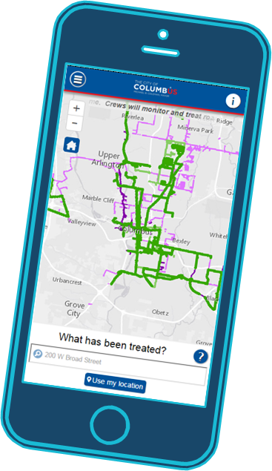
Web Applications
2
Google Analytics

Slide 15
Web Applications - Tracking
What is it?
Hosted Google Analytics
How do you set it up?
Create account
Add application and get a tracking code
Put tracking code in main page (index.html)
What does it do?
Usage
Device
Operating System
Network
Tip: URL you provide to google does not have to be real or accessible to Google
2
Notes:
What is it
How do you set it up
What does it do

Slide 16
Web Applications - Tracking
Widget Level Tracking
1. Create a second tracking site to get a unique tracking id
2. In you index section created above add:
ga('create', ‘TrackingID', 'auto',{'name': 'widgetTracker'});
3. In the widgets of interest, within .js files add this to functions:
if (ga){
ga('widgetTracker.send', 'pageview','MN_Widget/' + this.name);
}
Tip: Widget Level tracking, make sure tool only fires once + when expected
2

Slide 17
Web Applications – Analysis
2
Notes:
- How did we Analyze?
can either export data or interact with the metrics inside Google analytics
- Found that I have 6 applications that get less than 5 hits a day, one of these applications, I spend weeks upgrading

Slide 18
Web Applications – Analysis
2
Notes:
See transition from old to new app
If you are realeasing an application and are doing a redirect from a legacy app, you could see how much traffic is going to the new
Once a new app is released, you can keep a banner on the legacy application until traffic reduces to a level you are comfortable deleting URL

Slide 19
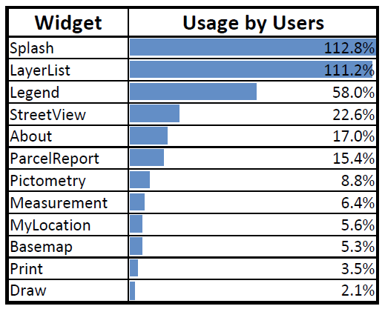
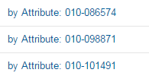

Web Applications – Analysis
Widget Usage
Overall for this period there were 376 Visit
Divided # times widget used/total # visit to get Percent Usage
Over 100% means widget was used more than once during a visit
Search Terms
Which part of your locator are they using
Find anomalies
2
Notes:
Overall shows that in this period there were 376 visits, I took that number and divided it by the number of times a widget was used to get the percent usage by user.
Splash and Layer list were used 100% of the time, because they open by default
This is only 1 application so far for 1 department, but our goal is to aggregate a lot more of this data to better understand what is useful and what the users are really using in an application so that we do not invest time or money down the road building things that are not frequently used
Search Terms – We recently had an issue where we realized with our locator, if you do not click on the auto-complete option, then it will not return results. Combined our Parcel id and owner name into 1 result, so if you just put in the PID and hit enter it would say no value found. In viewing the search terms you can see if the user was unsuccessful and gave up or if they eventually found their search term

Slide 20
Web Applications – Action
Prioritize applications by usage
Include popular widgets in existing and new applications
Decommission legacy applications that are not being used
Plug details into capacity planning tools to understand the load on our infrastructure
2

Slide 21
ArcGIS Server
3
Esri System Monitor

Slide 22
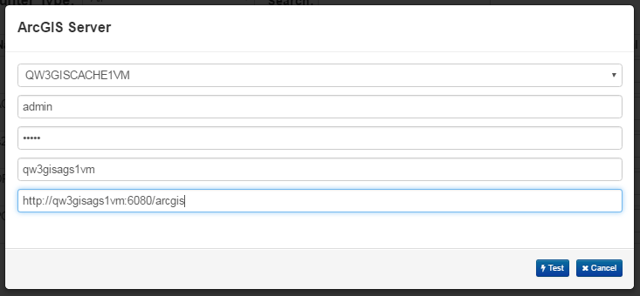
ArcGIS Server - Tracking
What is it?
ArcGIS System Monitor 1.6
Uses MongoDB
Contains an application and an agent service to collect metrics
How do you set it up?
Follow installation step to configure database, agent and application
Then add collectors
What does it do?
ArcGIS Server agent goes and pulls the ArcGIS Server log files
Consumes little to no resources on production server
Tip: Set-up on staging environment, never production
3
Notes:
What is it
How do you set it up
What does it do

Slide 23
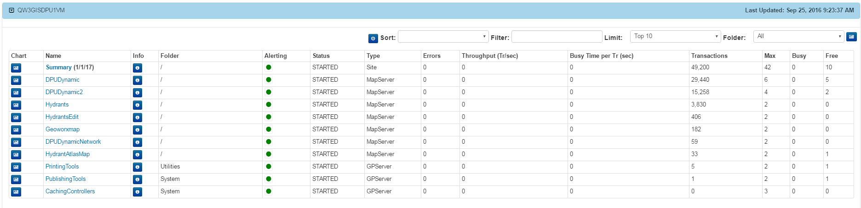
ArcGIS Server – Analysis
3
Notes:
Can configure monthly exports of tracking details

Slide 24
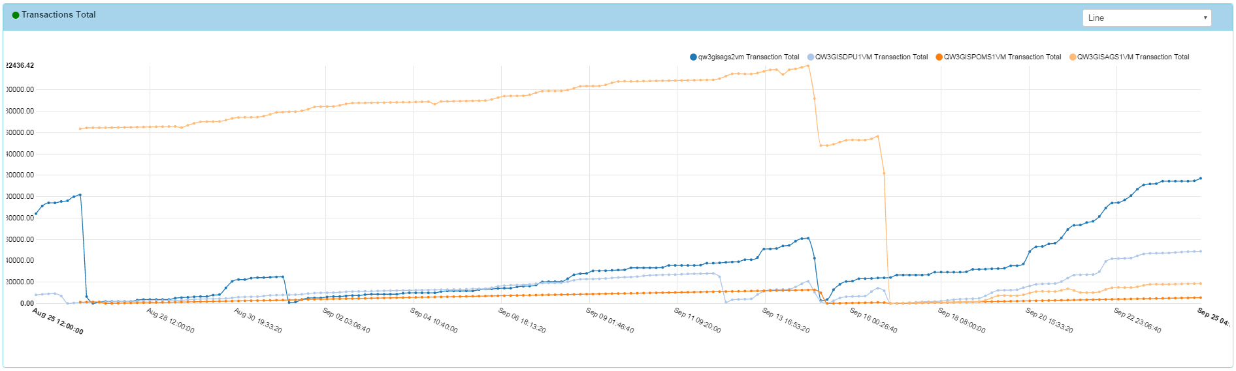
ArcGIS Server – Analysis
Distribution of load across environment
3
Notes:
Can configure monthly exports of tracking details

Slide 25
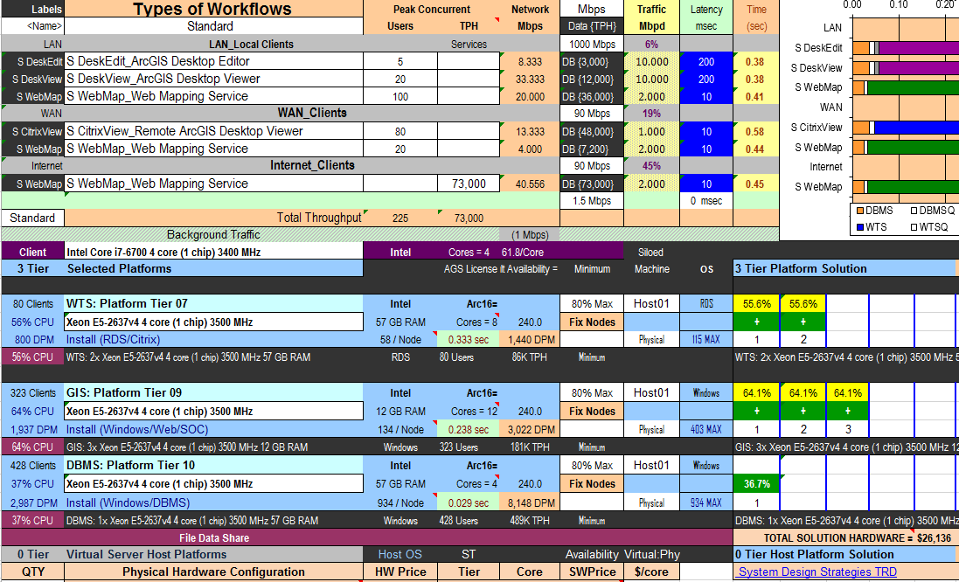
ArcGIS Server – Actions
Optimize Services
Set low utilized services to min instance of 0
Increase resources (min instances) on popular services
Migrate services so load is equaly balanced across environment
Plan for the Future
Leverage Capacity Planning tool to plan for future services
3
http://wiki.gis.com/wiki/index.php/Capacity_Planning_Tool
https://esri.box.com/shared/static/szig1zqcze425a81ezr6lcbyxgyth7m5.xlsx

Slide 26
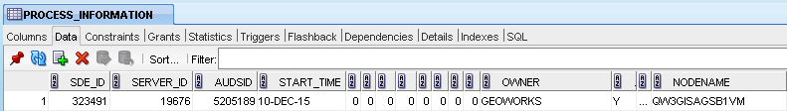
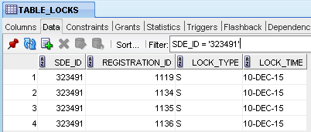
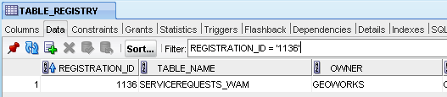
Database
4
Table/User Batch
Notes:
Combination of 3 tables within a database gives you User, Computer and Table.
PROCESS_INFORMATION
TABLE_LOCKS
TABLE_REGISTRY

Slide 27
Database - Tracking
What is it?
Database Trigger
New Log Table in SDE database
How do you set it up?
Create log table and trigger (documentation)
What does it do?
When there is a new record in Process Information Table, the trigger joins all 3 tables and writes to log
Records Feature Class, User and PC
4
Notes:
Set up a batch to run on an access database that has these joins set up to write to a table, or can set up a database trigger that any time a new record is entered into the process_information table, it would trigger the join and insert into a tracking table.
PROCESS_INFORMATION
TABLE_LOCKS
TABLE_REGISTRY

Slide 28
Database – Analysis
How to Analyze – Excel Template with Pivot Tables
List inactive/active tables
List most popular tables
Exact list of who used what when
Timestamp last FC was used
List of FC usage by Department
Show database usage over time
Cross reference with License Log by Computer Name to get ArcReader users/Single Use license users
4

Slide 29
Database – Actions
Verify/Notify Users about changes happening to a FC or outages to a FC
Archive Inactive Tables
Optimize the most used FC’s (run analyze, statistics more frequently)
Efficient Data Dissimenation Strategy focused around most popular FC’s
4
Notes:
Action – Plan to archive inactive tables. Perform additional maintenance steps to optimize most active feature classes. Create layer files for popular feature classes to provide easier access with pre-symbolized features

Slide 30
Ongoing
Track
Analyze
Action
Notes:
No matter large or small, whether you are responsible for a 30 server environment or deciding whether to buy 10 or 8 ArcGIS Server licenses next year, we can all benefit from tracking.

Slide 31
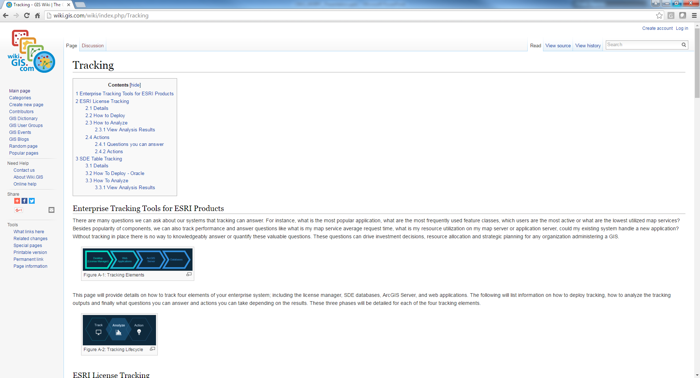
Place your screenshot here
Resources
Set-Up Directions
Downloadable Templates
Tracking result examples
http://wiki.gis.com/wiki/index.php/Tracking
Online Forum (Joe Guzi)
https://geonet.esri.com/groups/arcgis-system-monitor
This Presentation
https://github.com/jpmeade/TrackingPresentation

Slide 32

Thanks!
Any questions?
Jaclyn Meade – Software Engineer
City of Columbus
Notes:
Turn in final written narrative of project. Background + Lit Review + Plan of attack. 5-10 pages (before Christmas Due date)

